Slide 1
19- Dictionaries

Slide 2
Context
What is a dictionary? 4
Defining an empty dictionary 5
Types of keys and values 6
dict(key=value, key2=value2, …) | built in function 7
Ex.1 8
Add new key
dictObject[key] = value 9

Slide 3
Context (cont).
Access item in a dictionary
dictObject[key] 10
Ex.2 11
dictObject.get(key) 12
dictObject.get(key, valueReturn) 13
del dictObject[key] 14
Loop over dictionaries with for 15
Ex.3 16
dictObject.items() 17
Ex.4 18

Slide 4
What is a dictionary?
a collection of key value pairs.
We use it to map a key to a value

Slide 5
Defining an empty dictionary

Slide 6
Types of keys and values
keys
immutable So
quite often we use strings and numbers.
Value
any type

Slide 7

dict(key=value, key2=value2, …) | built in function

Slide 8

Ex.1

Slide 9

dictObject[key] = value

Slide 10

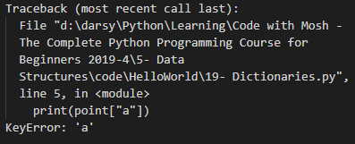
Access item in a dictionary dictObject[key]

Slide 11
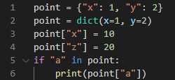
Ex.2

Slide 12
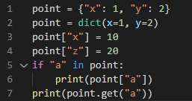
dictObject.get(key)

Slide 13
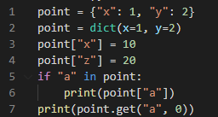
dictObject(key, valueReturn)
we can pass a default value
as the second argument. So we say. Hey. If you don't have an item with the key a return zero by default

Slide 14
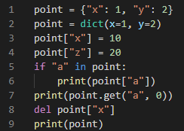

del dictObject[key]
Delete an item

Slide 15
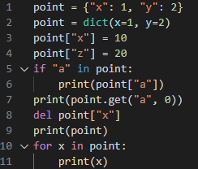

Loop over dictionaries with for
So in each iteration our loop variable will hold the key of an item

Slide 16
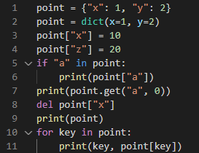

Ex.3

Slide 17
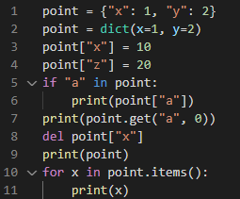

dictObject.items()
another way to iterate over a dictionary
in each iteration we get a topple
In this tuple We have the key and the value so we can unpack it

Slide 18
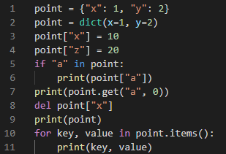

Ex.4

